Slide 1


WATER CRISIS INVESTIGATION
Maji Ndogo Water Crisis Investigation
This comprehensive analysis examines 39,650 water infrastructure records across Maji Ndogo, uncovering critical issues with water access, data integrity, and potential corruption. The investigation reveals that over half the population relies on inadequate water sources, with residents waiting an average of 137 minutes daily at shared taps. Additionally, systematic data tampering by field employees has compromised quality assessments, requiring immediate intervention.
2021-2023 ANALYSIS PERIOD
27.4M PEOPLE SERVED
5 PROVINCES

Slide 2
Investigation Objectives & Methodology
Data Integrity Assessment
Infrastructure Analysis
Evaluate accuracy and reliability of water source survey data across all provinces and identify potential manipulation patterns.
Identify water access patterns, infrastructure gaps, and critical service deficiencies affecting millions of residents.
Quality Assurance
Corruption Investigation
Cross-validate field surveyor data against independent auditor reports to ensure accuracy and accountability.
Identify potential data manipulation by field employees through statistical analysis and pattern recognition.
Database Structure
The md_water_services database comprises seven core tables tracking 56 employees, 39,650 locations across 25 towns, 60,097 survey visits, and 1,620 independent auditor reports. Data cleaning addressed email generation, phone number formatting, well pollution descriptions, and biological contamination classifications to ensure analytical accuracy.

Slide 3
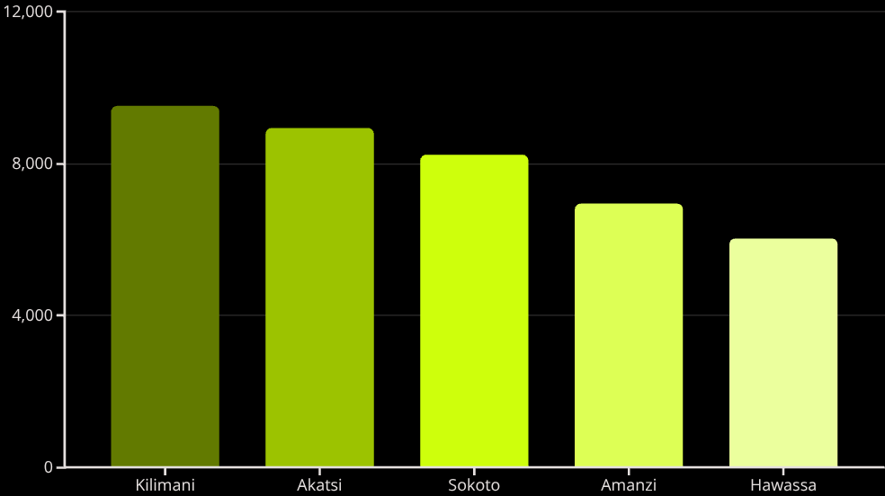


Geographic Distribution of Water Sources
60%
Rural Sources
23,740 water sources serve rural populations
40%
Urban Sources
15,910 water sources in urban areas
The geographic analysis reveals significant infrastructure challenges, with nearly 60% of water sources located in rural areas across five provinces. Kilimani leads with 9,510 sources (24%), while provincial distribution remains relatively balanced. This rural concentration indicates substantial access disparities and the need for targeted infrastructure investment in non-urban communities.

Slide 4

Water Source Types & Population Impact
Source Type
Count
People Served
% Population
Well
17,383
4,841,724
17.7%
Tap in Home
7,265
4,678,880
17.1%
Tap in Home (Broken)
5,856
3,799,720
13.9%
Shared Tap
5,767
11,945,272
43.6%
River
3,379
2,362,544
8.6%
Critical Finding: Shared taps serve 43.6% of the population (11.9M people) despite representing only 14.5% of water sources. This severe concentration creates dangerous bottlenecks and extreme wait times. Additionally, 3.8M people are affected by broken home taps, representing lost infrastructure investment that could be quickly restored.

Slide 5
The Queue Time Crisis
137
500+
839
Average Minutes
Extreme Locations
Hours Lost
Mean wait time at shared taps daily
105 sites with 8+ hour queue times
Annual time burden per shared tap user
Time Burden Analysis
Residents at shared taps lose an average of 2.3 hours daily collecting water, creating a significant productivity drain and quality of life impact. All 105 locations experiencing extreme queue times (over 500 minutes) were shared taps, with the worst locations averaging 279 minutes. Rivers show minimal wait times (17 minutes average), but represent untreated water health risks affecting 2.4M people.
SoRu34770224
KiRu25391224
AkRu05131224
279.6 minutes average queue time
279.0 minutes average queue time
276.0 minutes average queue time

Slide 6



Data Integrity Crisis Uncovered
Audit Results
94%
Matching Records
1,518 of 1,620 audited records verified accurate
6%
Discrepancies
102 records showed systematic score inflation
Independent auditor comparison revealed troubling patterns. All 102 discrepancies showed identical manipulation: auditors recorded scores of 0-9, while field surveyors consistently recorded perfect scores of 10. This systematic inflation suggests intentional data tampering rather than random errors.
Well Pollution Data Correction
Initial data quality review identified wells incorrectly marked "Clean" despite biological contamination exceeding 0.01 CFU/mL. Corrective actions included creating backup tables, updating contaminated descriptions to remove erroneous "Clean" prefixes, and reclassifying results appropriately. Final validation confirmed zero remaining errors in the cleaned dataset, ensuring accurate contamination assessments.

Slide 7

Employee Performance & Corruption Analysis
Employee Name
Error Count
Assessment
Bello Azibo
26
Highly Suspicious
Malachi Mavuso
21
Highly Suspicious
Zuriel Matembo
17
Highly Suspicious
Lalitha Kaburi
7
Moderate concern
Rudo Imani
5
Closest to average
Farai Nia
4
Below average
63%
6.0
Top 3 Employees
Average Errors
Account for 64 of 102 total discrepancies
Mean errors per employee baseline
Red Flag Identified: Bello Azibo, Malachi Mavuso, and Zuriel Matembo account for 62.7% of all discrepancies despite representing only 5% of the workforce. Pattern suggests systematic inflation of quality scores, possibly motivated by reducing workload, meeting performance targets, or accepting bribes from water source operators.

Slide 8




Critical Recommendations
Immediate Investigation
Launch formal inquiry into Bello Azibo, Malachi Mavuso, and Zuriel Matembo. Suspend these employees from field assessments pending investigation completion. Re-survey all 102 flagged locations with independent teams.
Emergency Infrastructure
Address 105 shared taps with extreme queue times (500+ minutes). Install additional tap points at high-traffic locations to immediately reduce wait times for the most affected communities.
Broken Tap Restoration
Prioritize repair of 5,856 broken home taps affecting 3.8M people. This represents quick-win infrastructure restoration that leverages existing investment and provides immediate relief.
Quality Control System
Implement dual-surveyor system for all future assessments. Establish random audits of 10% of surveys, GPS-tagged photo verification, and anonymous tip line for reporting corruption.

Slide 9

Long-term Strategic Priorities
01
Rural Infrastructure Expansion
Prioritize well construction and tap installation in rural areas serving 23,740 sources and 60% of the population.
02
Home Tap Conversion
Convert shared taps to individual home connections where feasible, reducing queue times and improving access.
03
River Replacement Program
Eliminate river dependence for 2.4M people through safe water source development and distribution network expansion.
04
Digital Monitoring System
Deploy GPS-tagged, photo-verified assessments with real-time data validation and automated anomaly detection.
Data Integrity Measures
Future governance improvements must include performance metrics based on accuracy rather than volume, third-party verification for scores of 8 or higher, comprehensive retraining programs on accurate assessment protocols, and enhanced accountability mechanisms. These measures will prevent future corruption while ensuring reliable data for infrastructure investment decisions.

Slide 10
Path Forward: An Integrated Approach
Infrastructure Crisis
Data Integrity Crisis
14.3M people (52%) rely on inadequate sources with extreme wait times up to 8+ hours daily
6.3% error rate with systematic score inflation by multiple employees compromising decisions
This investigation reveals a dual crisis requiring simultaneous action on infrastructure and governance. Without addressing corruption, infrastructure improvements may be misdirected to non-priority areas based on falsified data. Conversely, improved monitoring without infrastructure investment won't solve the underlying water access crisis affecting 27.4 million residents.
Integrated Action Plan
Phase 1: Immediate
Phase 3: Long-term
Investigation and corrective action for data integrity. Emergency deployment to 105 critical locations.
Rural infrastructure buildout, home tap conversion, river replacement, and digital monitoring rollout.
1
2
3
Phase 2: Short-term
Shared tap expansion, broken tap repairs, and dual-surveyor quality control implementation.
Success requires parallel execution: Reliable data enables smart infrastructure investment, while visible improvements build public trust in reformed governance systems. This integrated approach will ensure both accurate decision-making and tangible improvements in water access for Maji Ndogo's population.

